Slide 1


Final Year Project
Body Boost
Supervised By: Mr. Muhammad Usman Karim(Lecturer)

Slide 2
Project Team
Muhammad Ali Hamza (12826)
Anosh Junaid. (11359)
Hidayat Kiram (11939)

Slide 3
Table of Content
Introduction and Background
Literature Review and Summary Table
Problem Statement
Methodology
Progress Report Summary
Requirements
Software System (Design + Implementation + Testing)
Endeavour (Team)
Next Steps
Prototype / Report

Slide 4
Table of Content
Opportunity & Stakeholders
Solution
Progress Report Summary
Requirements
Software System (Design + Implementation + Testing)
Endeavour (Team + Work + Way of Working)
Next Steps
Prototype / Report

Slide 5
INTRODUCTION AND BACKGROUND

Slide 6
Introduction
BodyBoost is an application based on fitness
It provide users with workout and diet plans designed according to their emotional state.
It takes care of both physical and mental state.
By integrating social media textual data, the system captures real-time sentiments, enabling personalized workout and diet plans aligned with users' emotional states expressed.
Utilize technology to enhance the overall fitness journey, promoting holistic well-being.

Slide 7
Background
The concept for our fitness app emerged from extensive research conducted to understand the existing landscape of fitness applications.
Traditional fitness applications have primarily focused on exercise routines and nutritional guidance.

Slide 8
Literature Review
Studies showed that a variety of researchers from across the globe are working on sentimental analysis, health and fitness but very little work has been done on fitness app which takes user mental health and suggest workout plan and diet.
Fitbit, MyFitnessPal , Nike Training Club , 7 Minute Workout
Strengths: These application gives a wide ranges of trackers that monitors various activities.
Weaknesses: Lack of information of the user mental health lead it to the lack of wellbeing of the user.
Some advance features behind a premium feature, which may deter budget conscious user.

Slide 9
Summary Table
No. | Author Name | Language | Year | Machine Learning Methods | Data Description | Performance
1. | Facebook AL & | English | 2019 | RoBERTa and BERT | 160GB of text | SQuAD 94.6/89.4 88.5 on the GLUE benchmark
2. | Sunir Gohil, Sabine Vuik and Ara Darzi | English | 2018 | SVM , SVM, NB & k-NN | 12 papers were compared | 46% (92/2) of health-based tweets contain some form of positive or negative sentiment.

Slide 10
Summary Table
No. | Author Name | Language | Year | Machine Learning Methods | Data Description | Performance
3. | Muhammet Sinan Başarslan, Fatih Kayaalp | English | 2020 | NB, SVM & ANN | 4500 Twitter records of IMDB Movies & health-related twitter data | 0.85 Accuracy

Slide 11
Problem Statement
Lack of Emotional Integration in Fitness Apps: Due to limited emotional support many fitness apps mainly focus on physical exercises and diet plan but lack features addressing user’s emotional state. Users might feel a gap in the support provided.
Exercises and diet plan cannot be same for depress person and active person which leading to reduced app utilization and potentially hindering their fitness progress.
There is a critical need for a holistic fitness application that integrates sentiment analysis based on users' social media posts to tailor personalized exercise routines.

Slide 12
Solution
Personalized Fitness via Sentimental Analysis: The primary goal is to create a fitness app that continuously integrates physical and emotional well-being everyday.
This includes providing workout routines and diet plans a which are designed according to the emotional state of the person that are on users' social media sentiment analysis.
Monitor body composition effortlessly with our BMI Tracker.
Accessible through a user-friendly mobile app
Utilize technology to enhance the overall fitness journey, promoting holistic well-being.

Slide 13
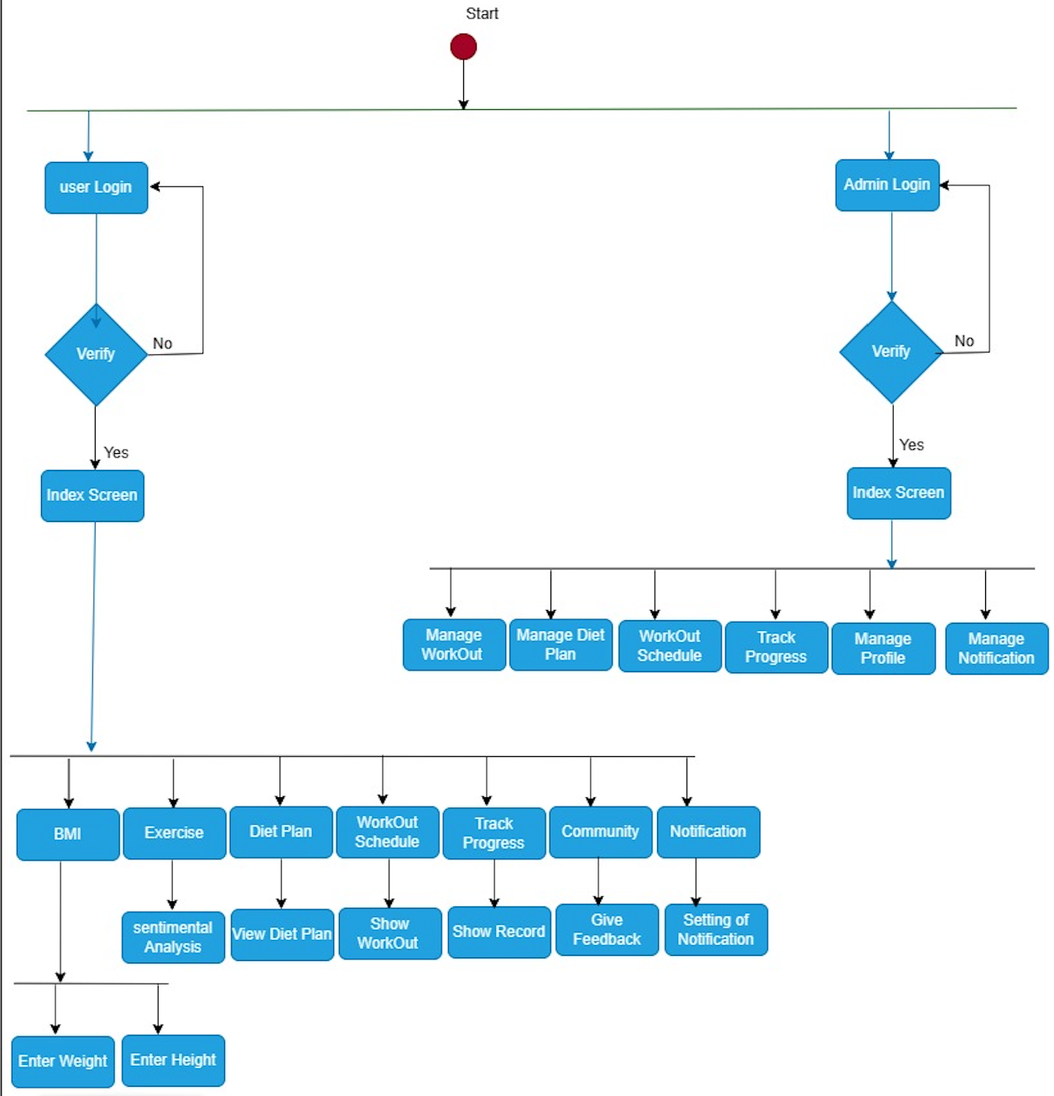
Methodology

Slide 14
Methodology
The user provides their login credentials, and the system verifies them. Once verified, the user is redirected to the main screen (Index Screen), which offers functionalities like BMI, Exercise, and Diet Plan.
The user can access various features through the main screen, including functionalities like Workout Schedule and Workout Tracking (Manage Functionalities), as well as Admin Functionalities such as Manage Profile, Manage Notification, and Setting of Notification.
In the context of above diagram, these points cover the major features and functionalities of the system.

Slide 15
Opportunity & Stakeholders

Slide 16
Opportunity
Holistic Well-being Focus: Recognizing the growing importance of both physical and emotional health, our app seizes the opportunity to give to individuals seeking a comprehensive approach to fitness that addresses both aspects.
Identified Market Gap: By looking into existing fitness apps, we found that there was something important missing, giving us an opportunity to create a more complete solution. by combining both physically and emotionally. The app capitalizes on the opportunity to gather valuable insights from social media, we realized that social media can help us understand users better, making our app even more special in the fitness world.

Slide 17
PROGRESS REPORT Summary

Slide 18
Stakeholders
Trainee: Trainee are interested in a user-friendly interface, personalized workout plans, Diet plan and the effectiveness of the sentiment analysis feature.
Admin: Admin will mange user, workout ,diet plans and checking the effectiveness of sentiment analysis feature

Slide 19
Requirements
Our project has two users:
User/Trainee
Admin
Use Cases : 18
Functional Requirements: 16

Slide 20
Design
Detailed Design
Architectural Design
Use Cases
Trainee Use-Case Diagram
Admin Use-Case Diagram
Database Schema Diagram
Methodology Diagram

Slide 21
Implementation
Development Tools & Technologies
IDEs and Tools
Backend: Python
Flutter: Android Studio
Collaborative Model Training: Google Colab
Version Control and Document Sharing: GitHub
Containerization: Not Applicable
Technologies
Backend: Python
Framework: Google Colab
Machine Learning: Hugging Face Transformers , sklearn
Database: MongoDB

Slide 22
Best Practices / Coding Standards
Best Practices
Version Control: GitHub
Continuous Integration and Deployment Practices
Coding Standards
Project Jupyter code
Flutter: Followed Flutter's Coding Standards

Slide 23
Libraries / Components / Web Services
Libraries
Transformers
Sklearn
Flutter SDK
Components
Roberta model
Naïve baye Model
Google Colab
Flutter Application
Visual studio code
Web Services
MongoDB Database

Slide 24
Testing
Test Data | TD-2
Form | Login
Stakeholder | User
Field | Password
Technique | Equivalence Partitioning
Valid | Password length should be >=9. Includes two special characters. Includes uppercase and lowercase character Includes one numeric character
Invalid | Password length < 9 No uppercase and lowercase characters No special character No numeric character

Slide 25
Testing
Test Data | TD-1
Form | Sentimental analysis
Stakeholder | User
Field | Enter your tweet /caption/ words about yourself
Technique | Equivalence Partitioning
Valid | Correct Length Input length should be >=5 Input length should be <25
Invalid | Not contain @user Not contain “http” Special characters

Slide 26
Endeavour

Slide 27
Endeavour
Names | Roles
Anosh Junaid | Front-end, Back-end Documentation
Muhammad Ali Hamza | Model-Train, Back-end, Documentation
Hidayat Kiram | Front-end, Documentation

Slide 28
NEXT STEPS

Slide 29
Work Breakdown Structure (List of all Deliverables / Strikethrough Completed Deliverables)
Data Collection and Processing
Sept-Oct
Flutter App Development
Oct-Nov
Model Training
Nov-Dec

Slide 30
Challenges
Finding Dataset
Twitter API
Scrapper API
Model Training Hurdles
Front-End Development Challenges
Database Connection

Slide 31
Prototype & Report

Slide 32
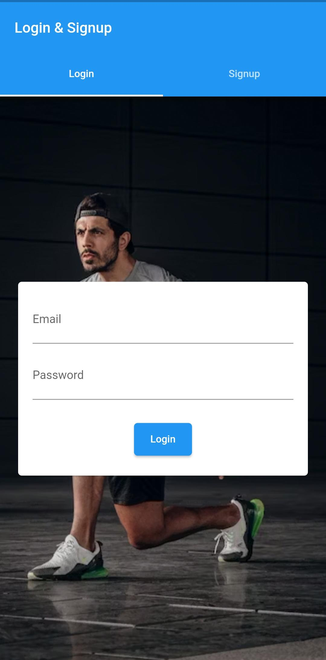
Prototype

Slide 33
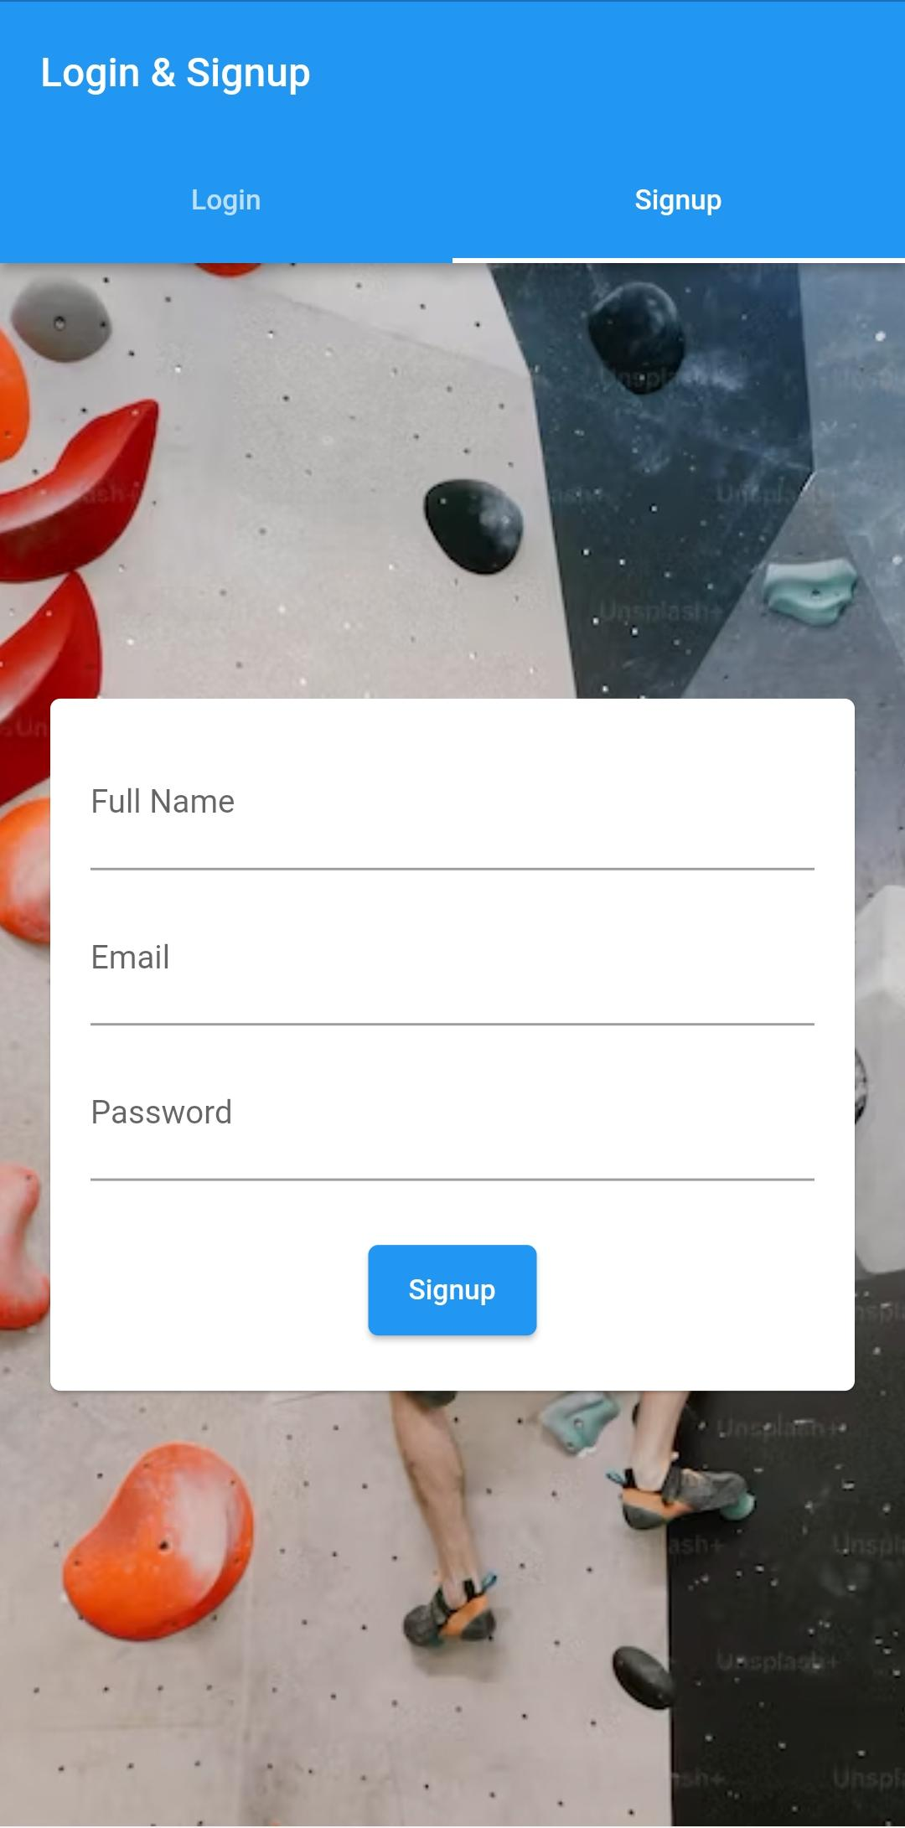
Prototype

Slide 34
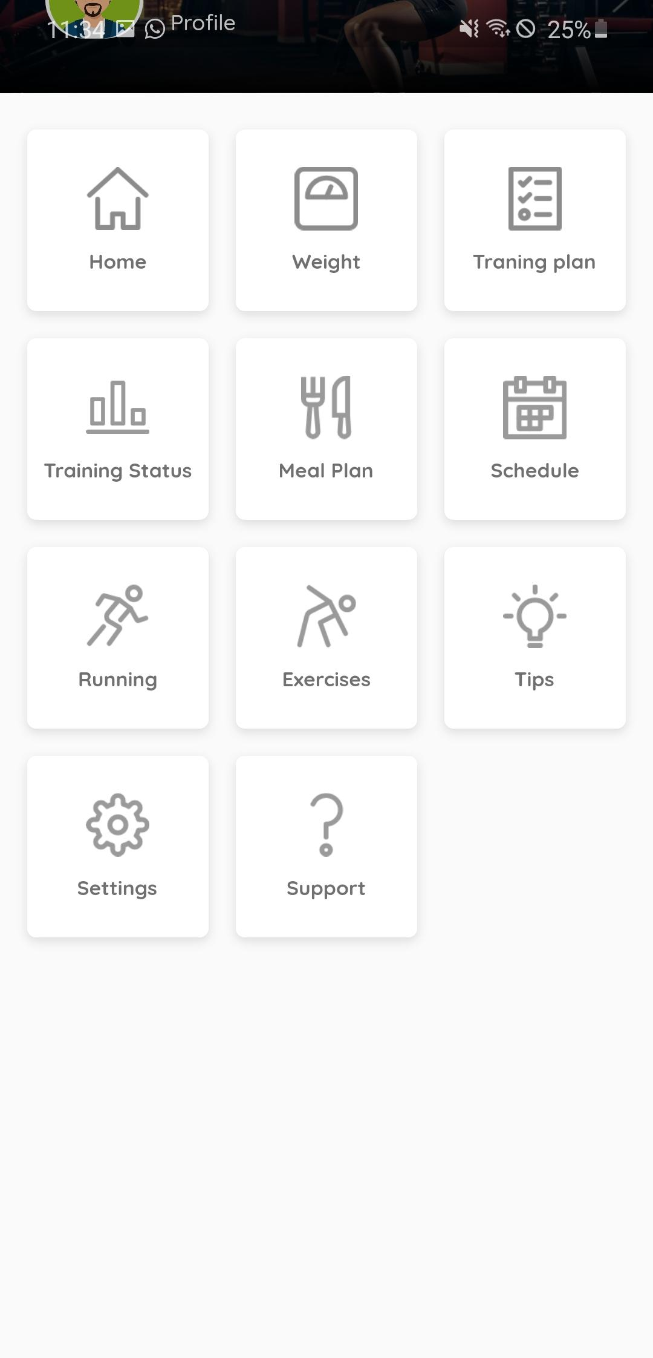
Prototype

Slide 35
Report
Chapter 1: Introduction
Chapter 2: Literature / Market Survey
Chapter 3: Requirement Analysis
Chapter 4: System Design
Chapter 5: Implementation
Chapter 6: Testing & Evaluations
Chapter 7: Conclusion & Outlook

